Slide 1
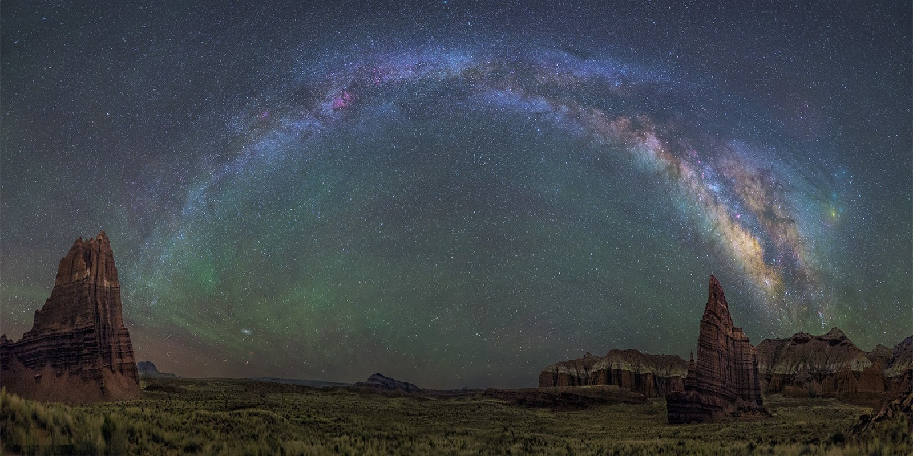
Observing the Night Sky

Slide 2
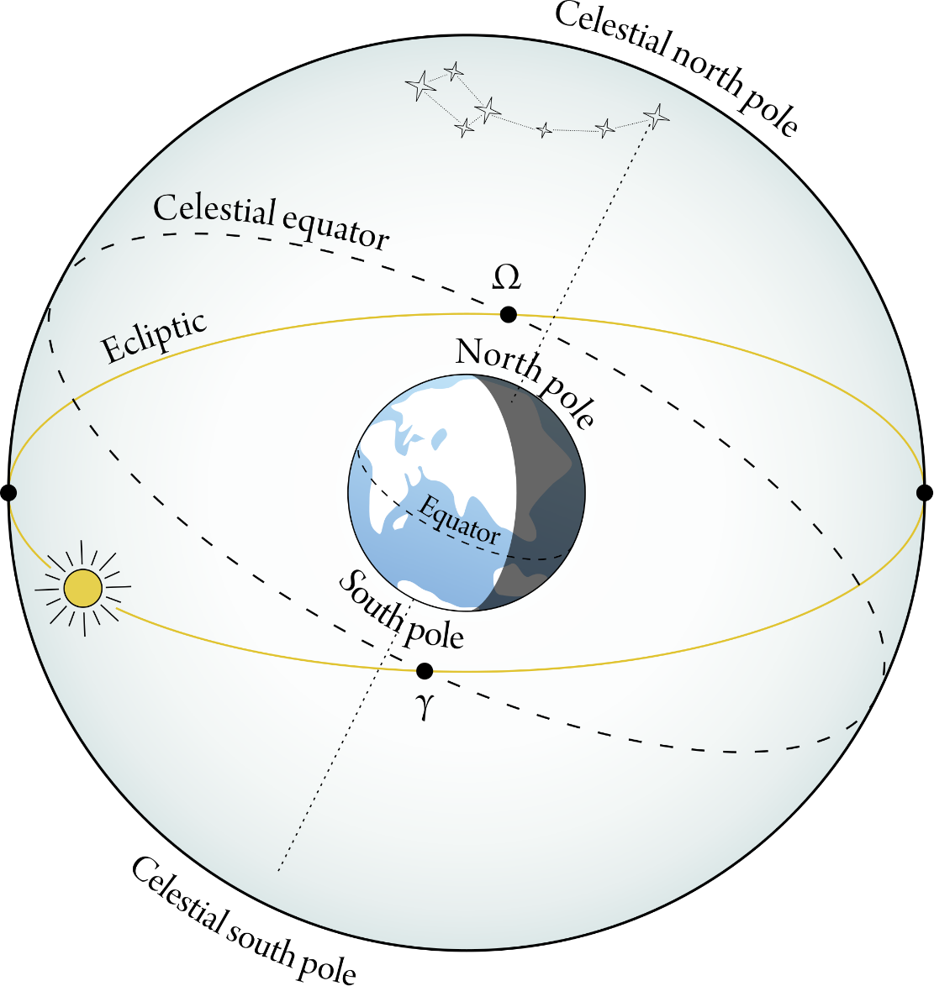
What is the elevation of the Celestial Equator in Iowa City?
0º
23.5º
42º
48º
90º

Slide 3
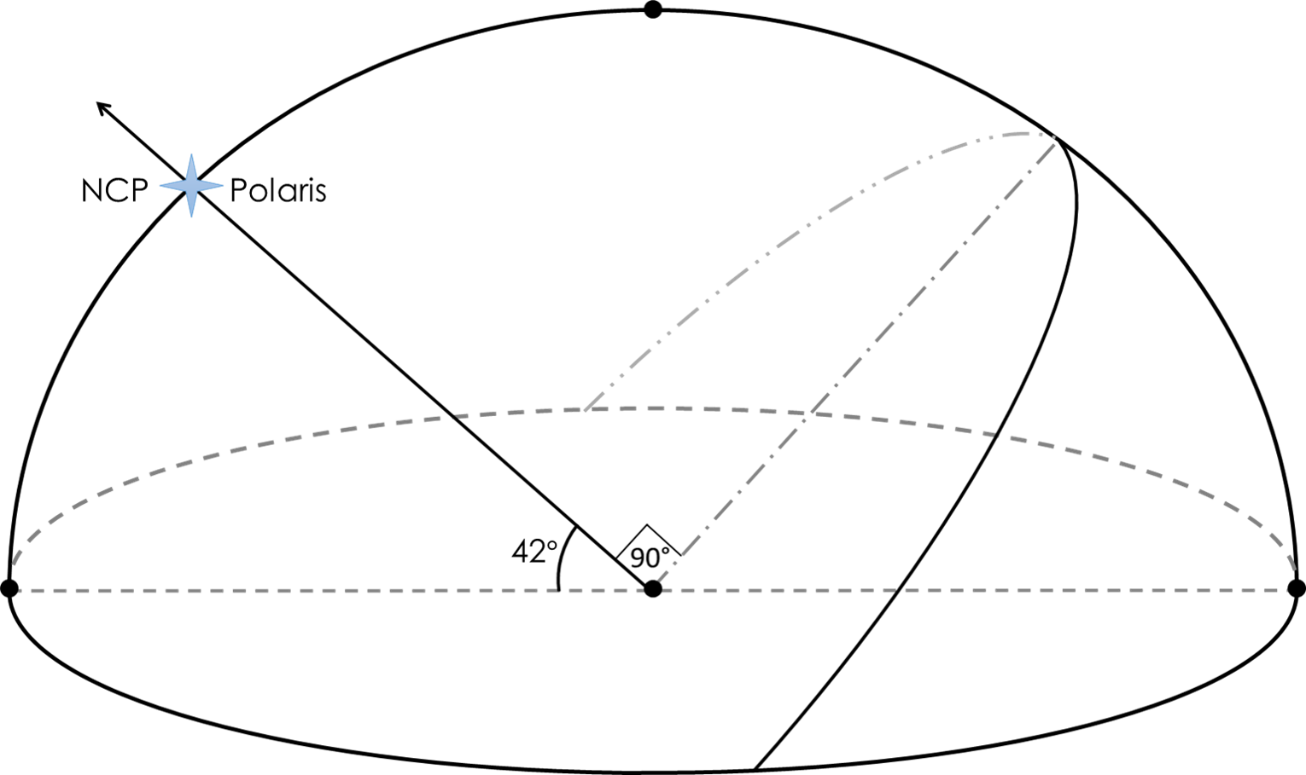
What is the elevation of the Celestial Equator in Iowa City?
Meridian
Zenith
48º
E
Horizon
48º
N
S
W

Slide 4
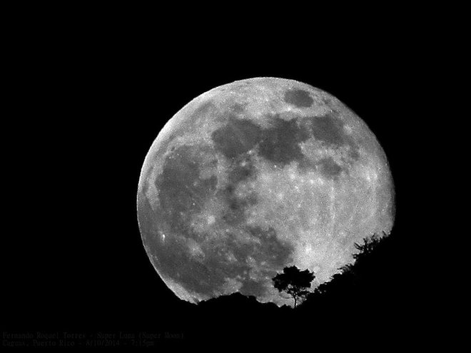
What is, approximately, the angular size of the full moon?
1˚
5˚
10˚
15˚
25˚

Slide 5
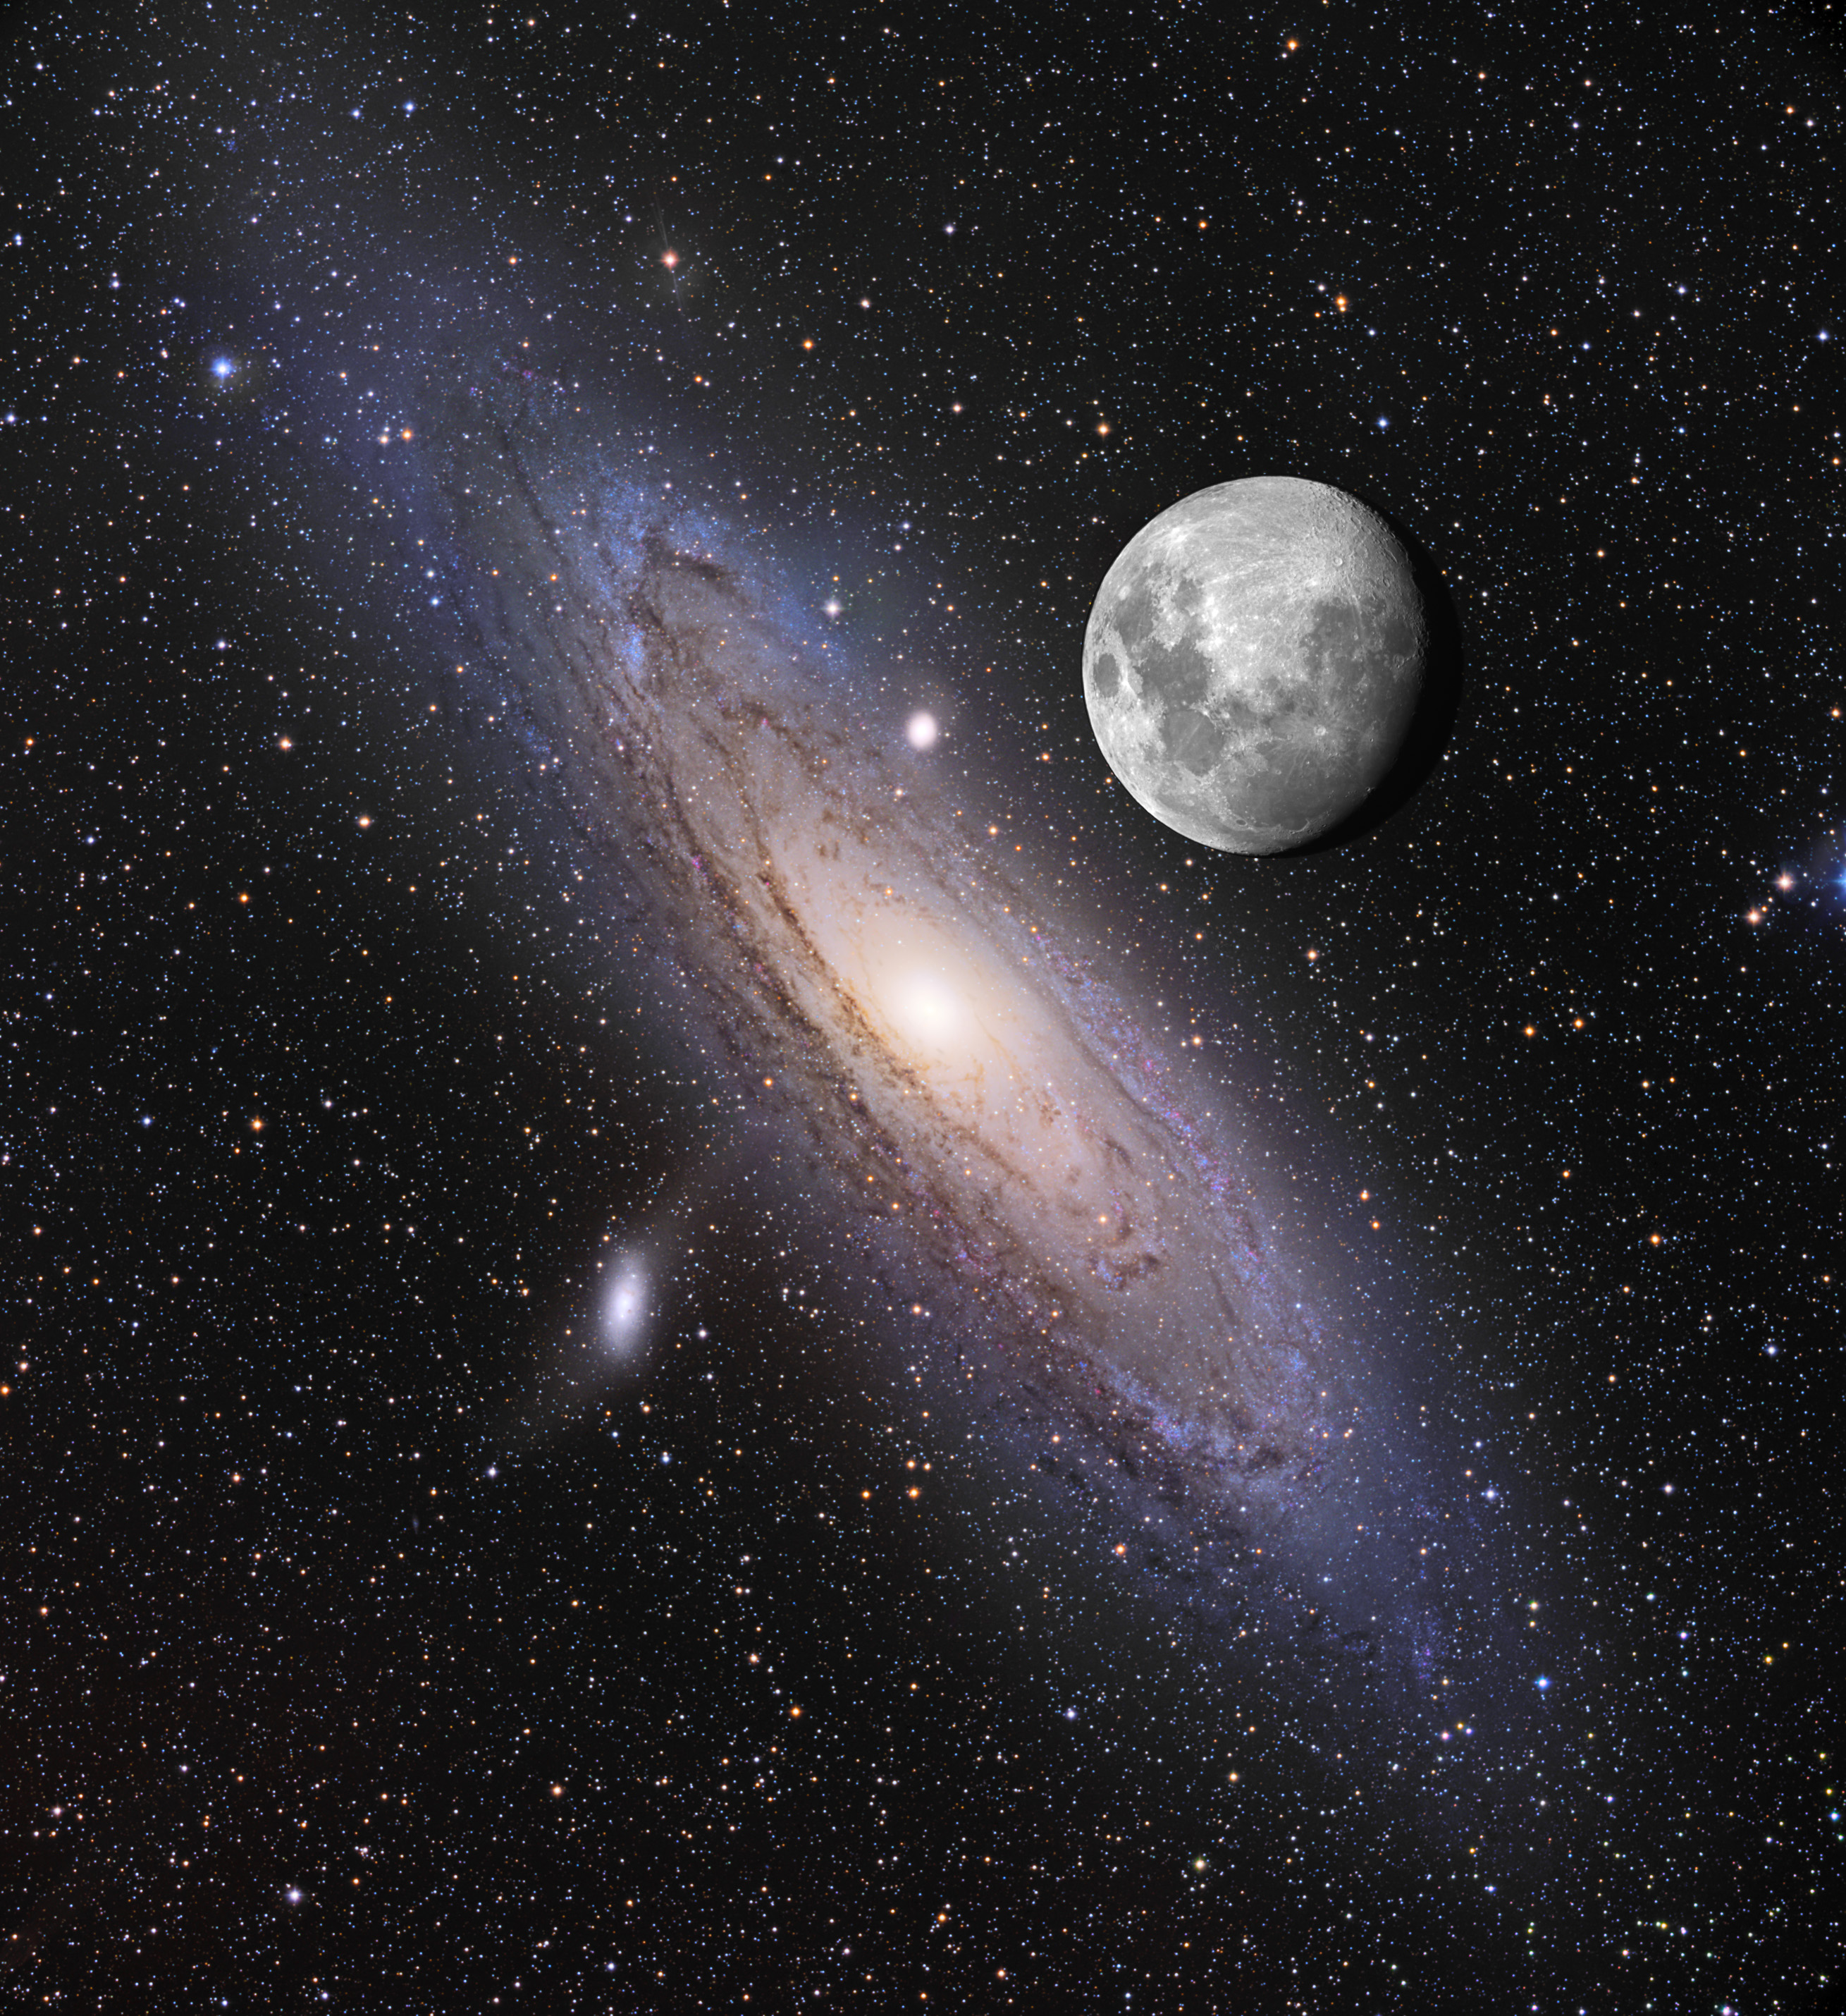
What is, approximately, the angular size of the full moon?
1˚
½˚
3˚

Slide 6
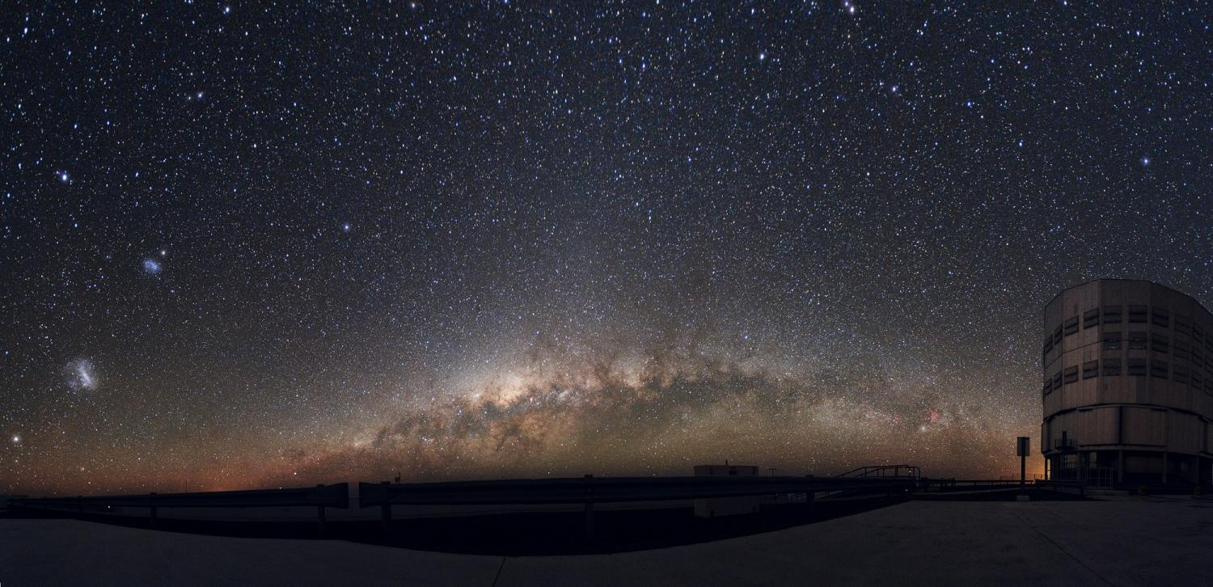
SMC
5˚
LMC
10˚

Slide 7
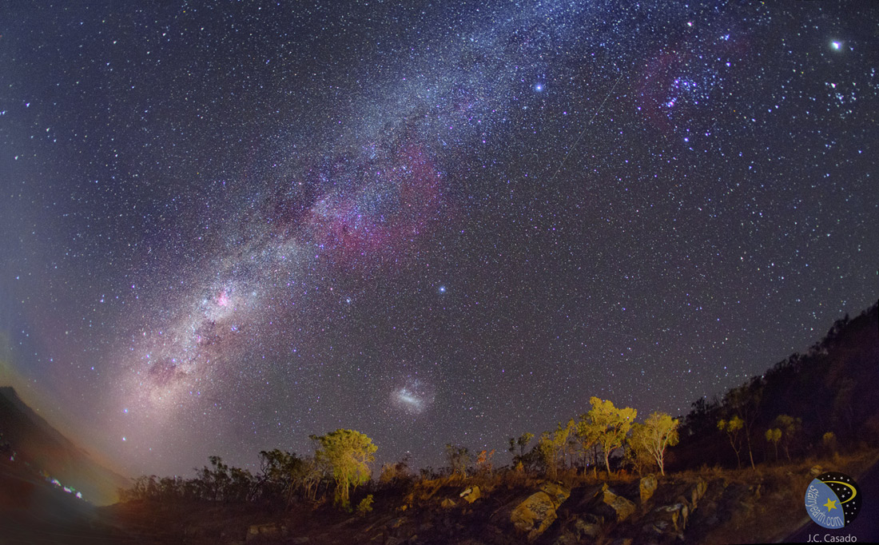
Gum
Nebula
40˚
LMC
10˚

Slide 8
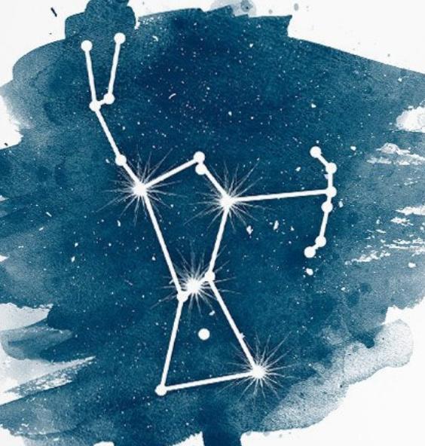
Which of the following asterisms (star patterns) is located next to Orion?
Spring Triangle
Summer Triangle
Winter Triangle
Northern Cross

Slide 9
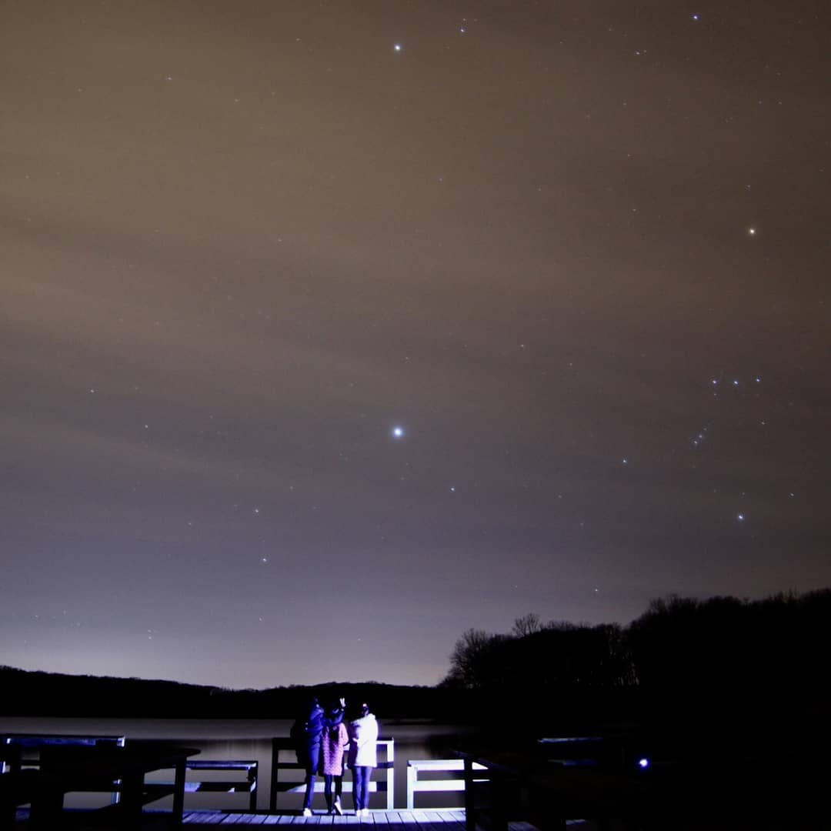
Which of the following asterisms is located next to Orion?
Procyon
Winter Triangle
Betelgeuse
Sirius
Photo Credit: Jiajing Zhang

Slide 10


Why are the planets Venus and Mercury never up at midnight?

Slide 11
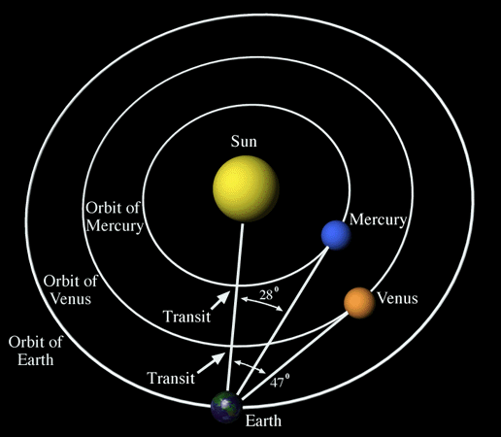
Why are the planets Venus and Mercury never up at midnight?
They orbit closer
to the Sun

Slide 12
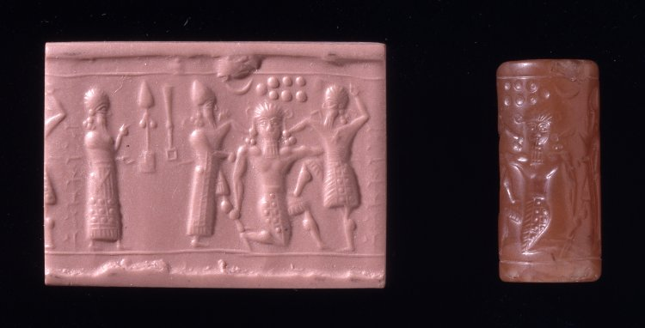

Slide 13
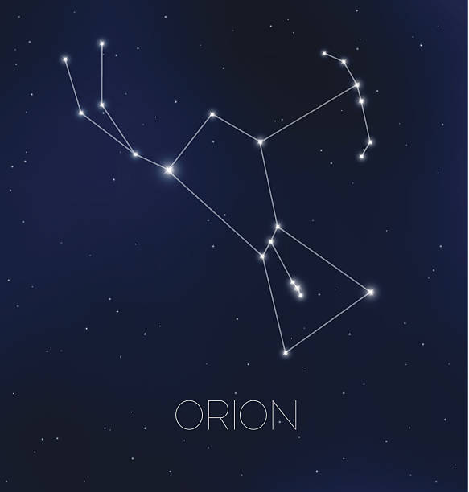
Gilgamesh
Gilgamesh took the axe,
he slung the quiver from his shoulder,
and the bow of Anshan,
and buckled the sword to his belt
Notes:
3. Taurus the bull is another ancient constellation, having possibly been identified among the cave paintings of Lascaux, France. In the Greek tradition, Taurus is sometimes seen as the god Zeus, having transformed himself into a bull to abduct Europa. In another tale, Taurus is thought to represent Zeus’ mistress Io, whom Zeus transformed into a bull to hide from his wife, Hera.
The constellations Taurus and Orion face one another, preparing for an epic clash. This alignment may have been the inspiration for the Mesopotamian poem, The Epic of Gilgamesh. The description of Gilgamesh closely parallels Orion (see a star wheel, activate the constellation lines in Stellarium, or see pg. 121):
Gilgamesh took the axe, he slung the quiver from his shoulder,
and the bow of Anshan, and buckled the sword to his belt
To gain renown, Gilgamesh sets out with his friend Enkidu (this star of heaven which descended like a meteor from the sky) to defeat the monster Humbaba the Terrible:
Let Enkidu lead the way, he knows the road to the forest…
the mountain of cedars, the dwelling place of the gods…
Now the mountains were moved and all the hills,
for the guardian of the forest was killed…
The seven splendours of Humbaba were extinguished.
Afterwards, Gilgamesh is courted by the goddess Ishtar, but he spurns her marriage proposal. In retaliation, Ishtar unleases Gugalanna (the bull of heaven) upon Gilgamesh. Enkidu, however, seizes the bull’s tail, allowing Gilgamesh to thrust his sword through the back of the bull’s neck. Enkidu then rips out one of Gugalanna’s hind legs and hurls it at Ishtar (in ancient Egypt, Ursa Major was seen as a bull’s leg, while the back of Taurus is missing).
Gilgamesh’s journey can be associated with the Sun’s journey through the heavens. Humbaba is first extinguish along with his seven radiances (corresponding to seven trees). As the Sun continues its journey, the rest of Taurus is consumed from the rear,
When they had killed the Bull of Heaven they cut out its
heart and gave it to Shamash [the Sun]
What celestial object is associated with Humbaba and his seven radiances, which sets (and rises) just before the rest of Taurus and is also illustrated on an 8th century BC neo-Assyrian cylinder seal depicting Enkidu and Gilgamesh flanking Humbaba?

Slide 14
Enkidu This star of heaven which descended like a meteor from the sky
Let Enkidu lead the way,
he knows the road to the forest…
the mountain of cedars,
the dwelling place of the gods…
Now the mountains were moved
and all the hills,
for the guardian
of the forest was killed…
The seven splendours of Humbaba
were extinguished

Slide 15
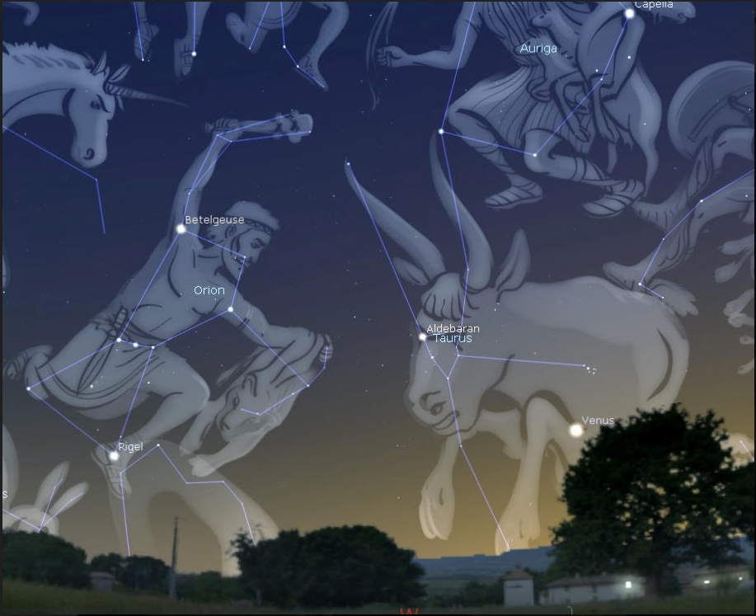
Ishtar
Courts Gilgamesh
Rejected
Unleashes Gugalanna
The bull of heaven
Gugalanna Defeated
Enkidu seizes bull’s tail
Gilgamesh thrusts sword through back
Enkidu rips off hind leg, hurls it as Ishtar

Slide 16
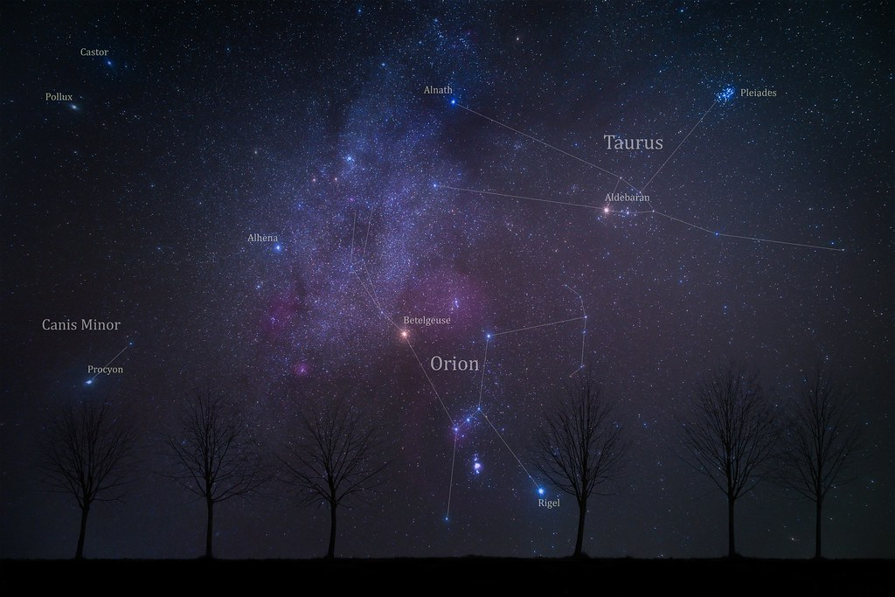

Slide 17
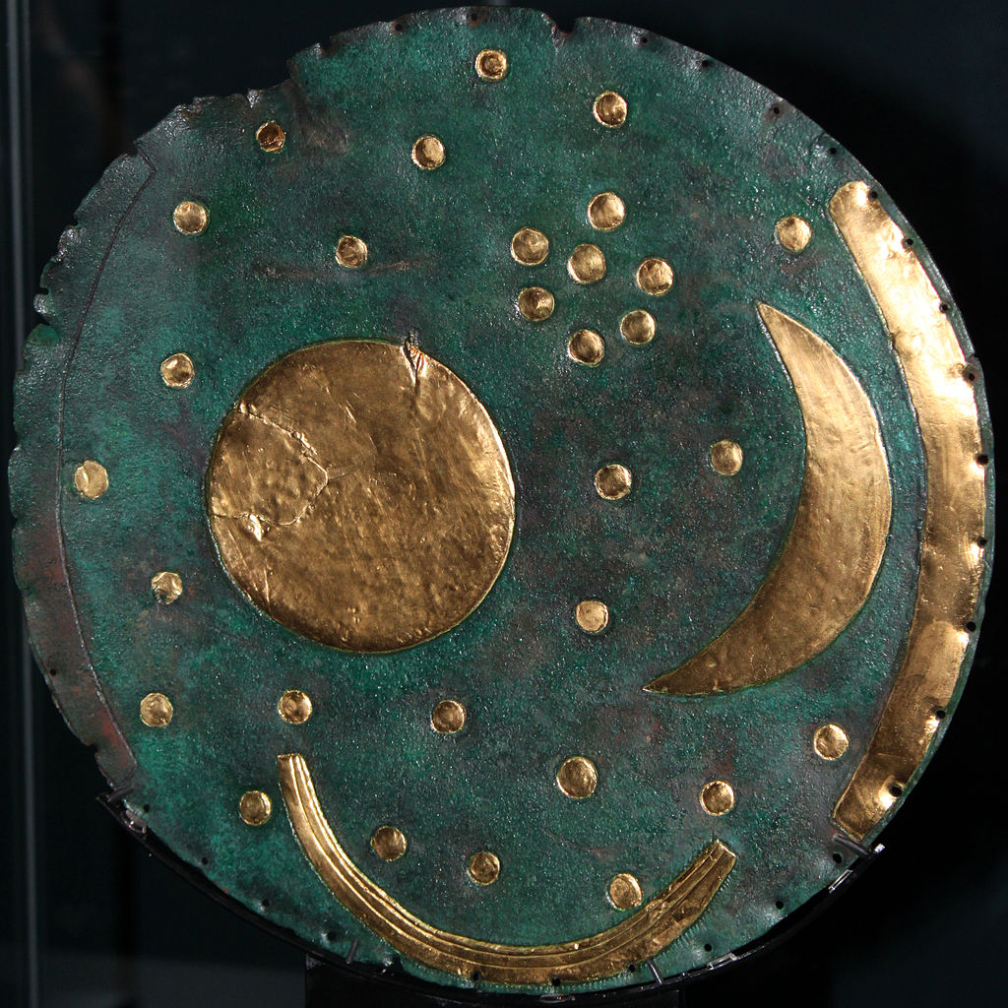
Nebra Sky Disk (~1600 BC)
Pleiades?
Discovery (1999)
Germany
Henry Westphal & Mario Renner
metal detector
Illegal activity
damaged the disk
sold to German dealer
Retrieval (2002)
Posted on black market for ~$350,000
Police raid (Switzerland)

Slide 18
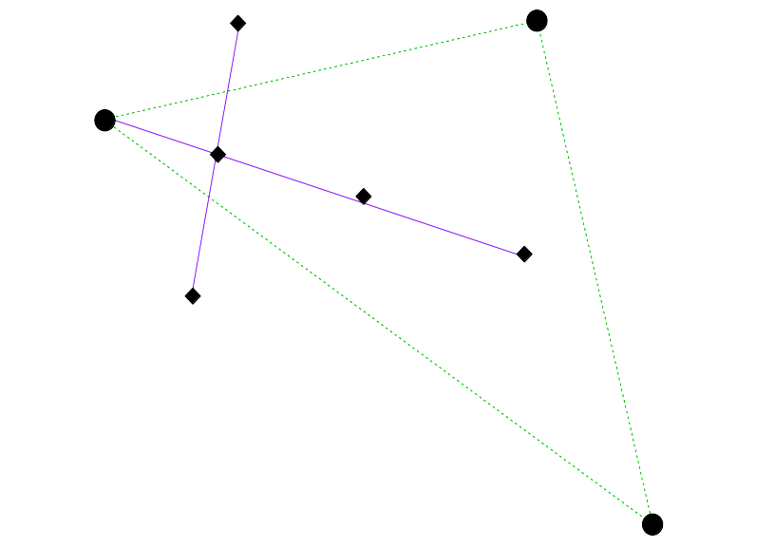
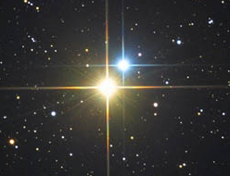
Fawaris
Vega
Deneb
Aljanah
Tarazed
Altair

